Slide 1
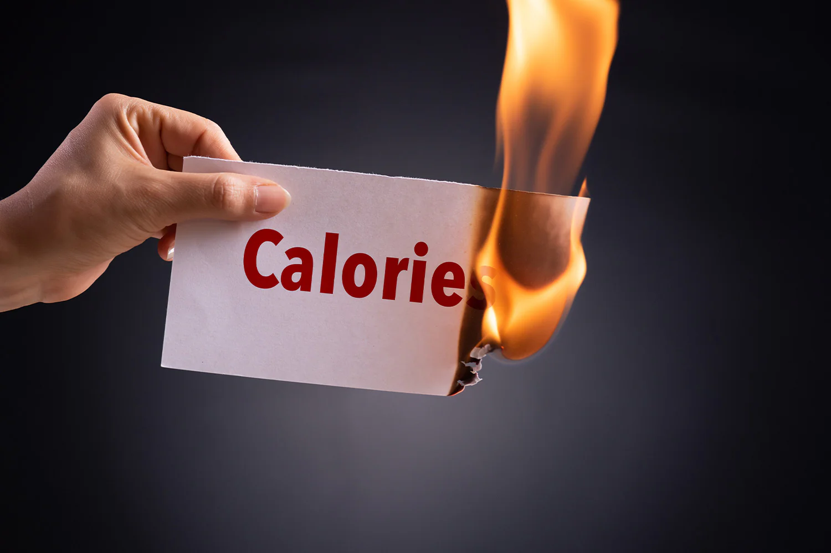
Summer Internship Report Presentation
Calories burnt Prediction Using Machine Learning

Slide 2
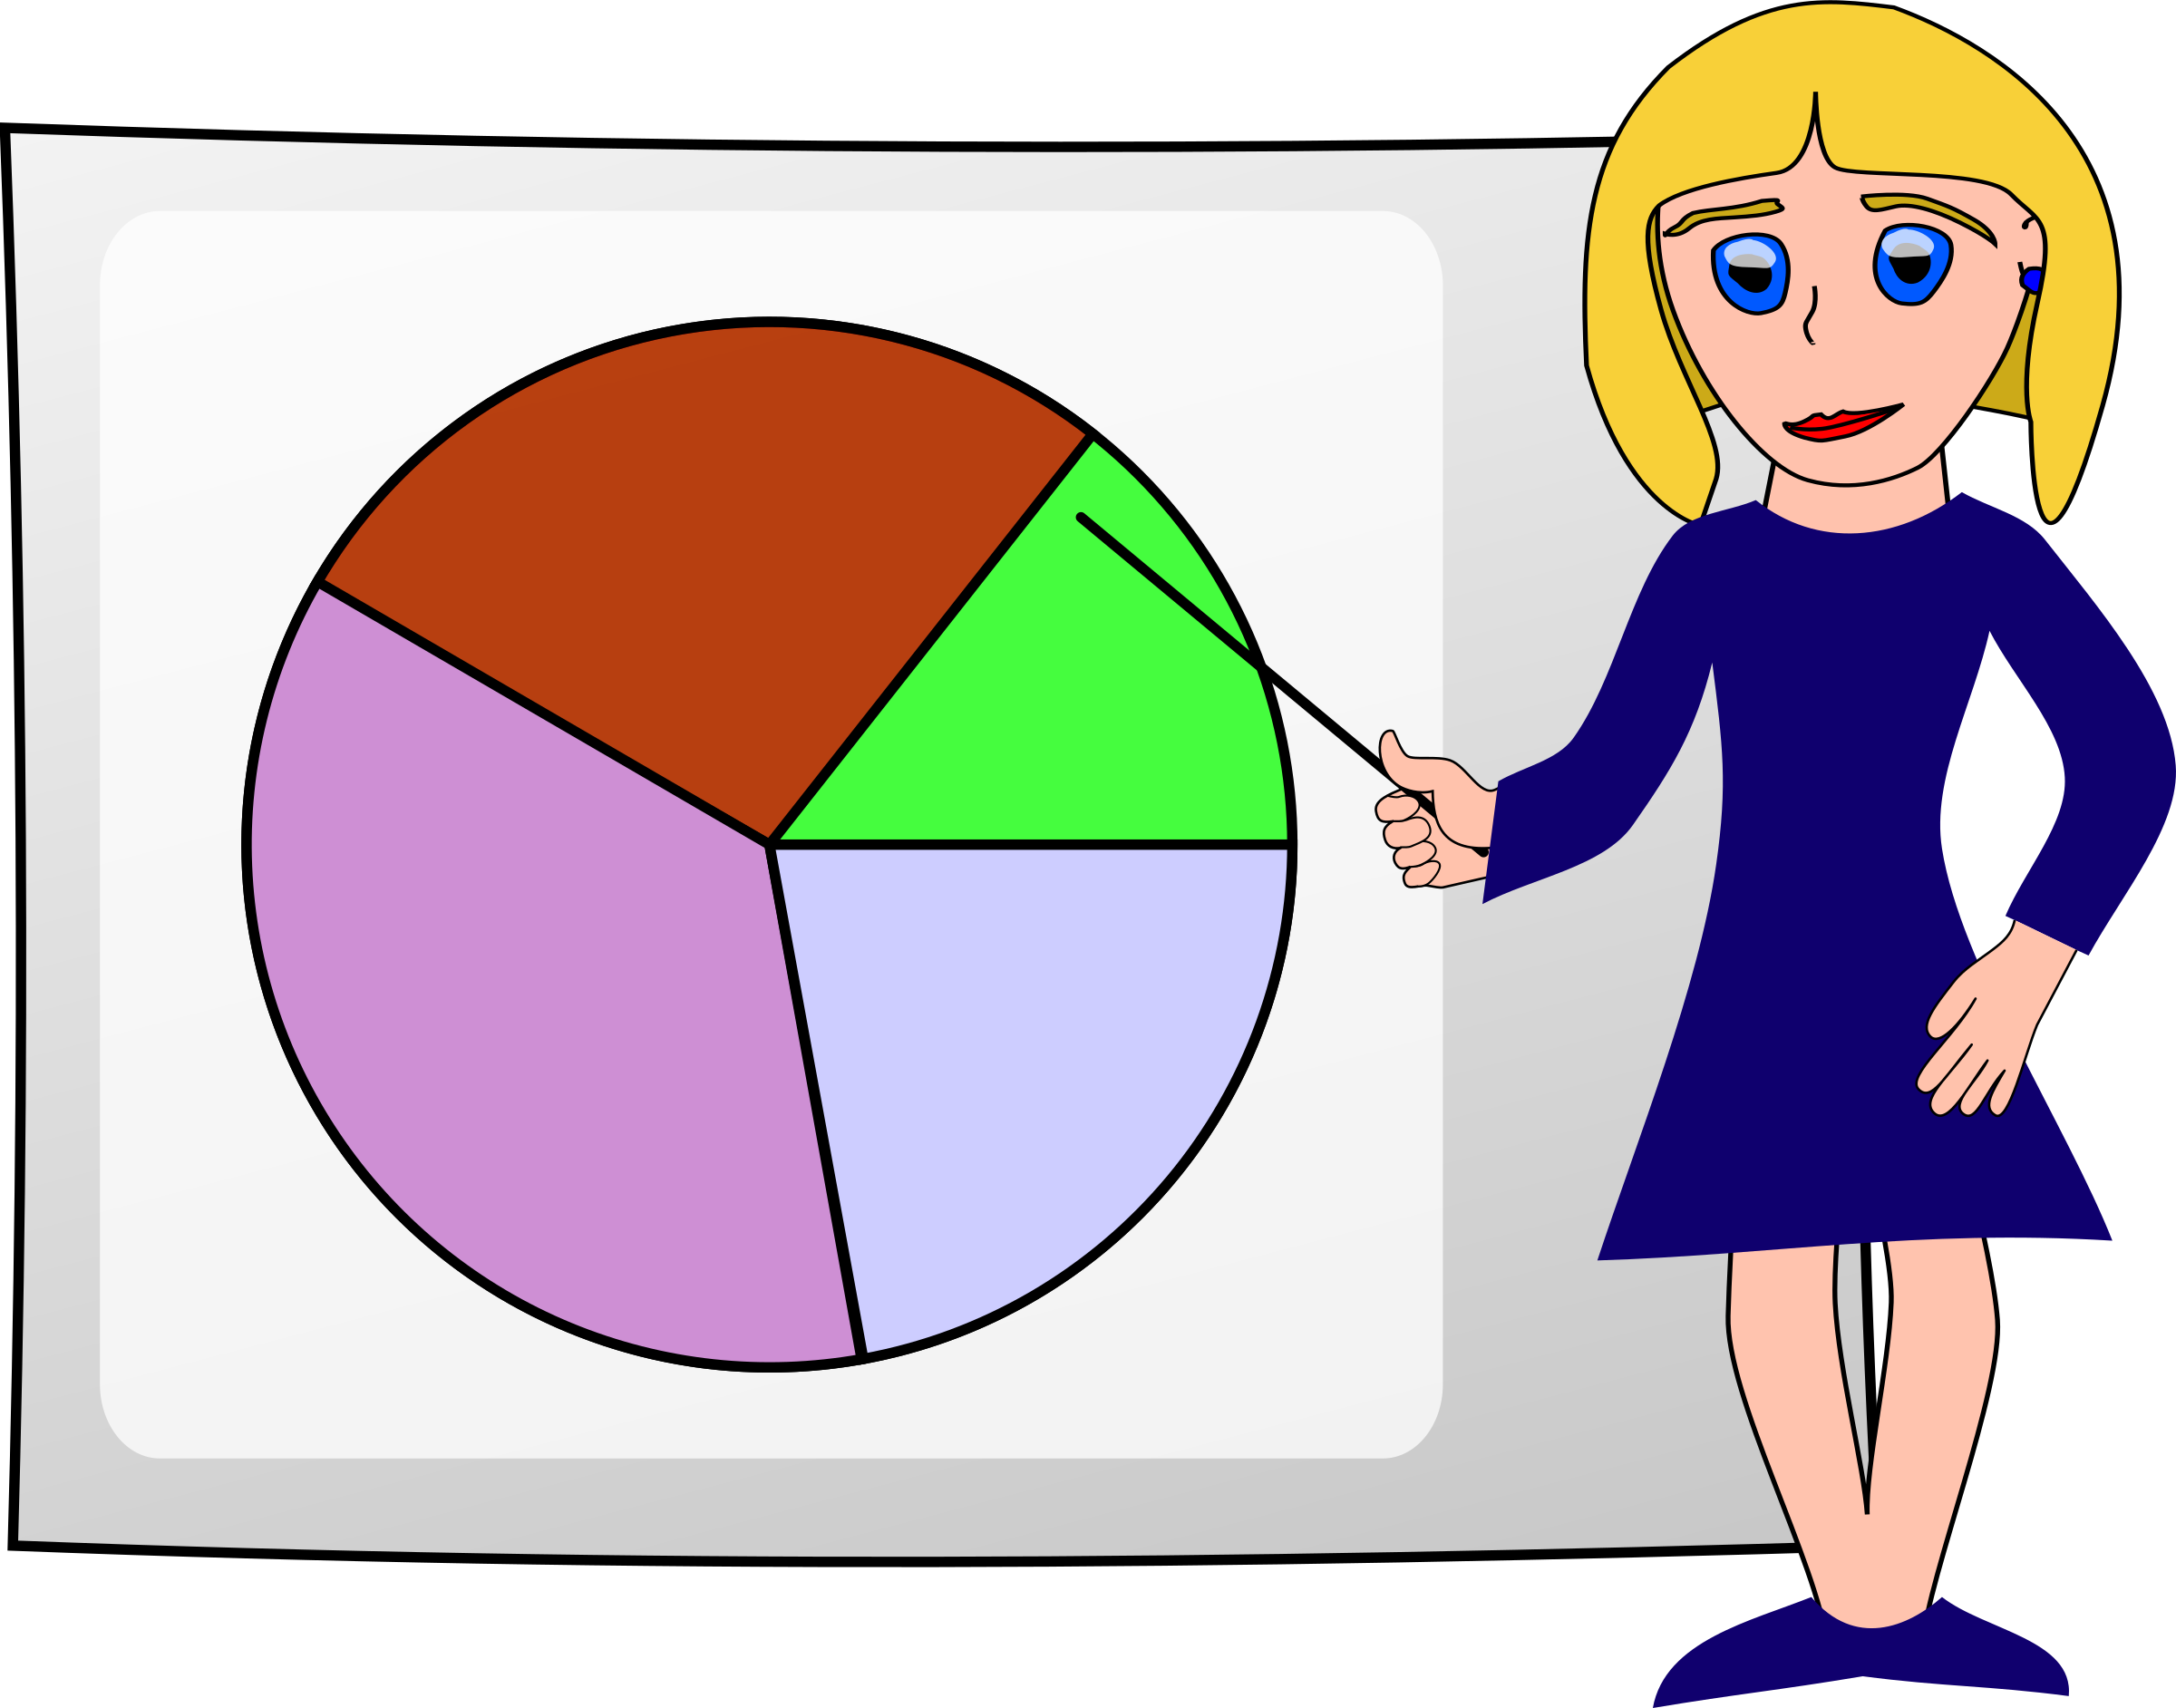
Presented By
ARYA VIRAJ KOTHADIYA
APURVA RAVINDRA ZAGADE
MAITHILI AMBAR SHINDE
YOGITA VINESH KAMBALE
Project Guide
Prof.Prayjot Patil.Sir

Slide 3







index
Work Flow
Objectives
Introduction
Abstract
Conclusion
Graphical Representation
Data Analysis

Slide 4
Abstract
In Growing Technological Era People Are Less Aware Of Their Health And Mental Stability. Due To Lack Of Time, They Include More Junk Food Then Healthy Options ,Which Leads To Increases The Total Calories Rate In Their Body. So We Do Calorie Burn Prediction By Machine Learning Algorithm . The Aim Of This Project To Predict The No Of Calories Burn By An Individual During Physical Activity Using Machine Learning.

Slide 5

Introduction
Today, people have very tight schedules due to changes in their lifestyle and work commitments. Health and fitness are becoming increasingly important to individuals and society as a whole. As people seek to live healthier lifestyles, they are turning to wearable devices and fitness trackers to monitor their physical activity and track their progress. One important metric that these devices track is the number of calories burnt during physical activity. But it requires regular physical activity to stay fit and healthy. People do not pay attention to their eating habits leading to obesity. Obesity is becoming a big and widespread problem in today's lifestyle. This makes people choose diets and do a lot of exercise to stay fit and healthy. The main thing here is that everyone should have complete knowledge of calories consumed and burned. Calorie is a unit of hear energy. Calories are the units of energy required to raise 1 gram (g) of water by 1°C The amount of calories burnt depends on internal and external factors, it is subjective and different for everyone depending on their height, weight, and fitness level. Body performs some extensive activity or workout the body temperature and heart rate start rising which leads to the production of heat energy in the body. Which ultimately causes calories to burn. To show the same we take some input parameters such as age, gender, height, and weight.

Slide 6

Objectives
Develop a machine learning model to predict calories burned based on physiological and exercise-related features.
Evaluate the performance of the model using metrics such as mean absolute error and R-squared.
Visualize the results using seaborn plots.
Compare the performance of the model with traditional methods of estimating calories burned.
By achieving these objectives, this project aims to contribute to the development of personalized fitness and weight management solutions, and demonstrate the potential of machine learning in improving our understanding of physical activity and exercise.

Slide 7
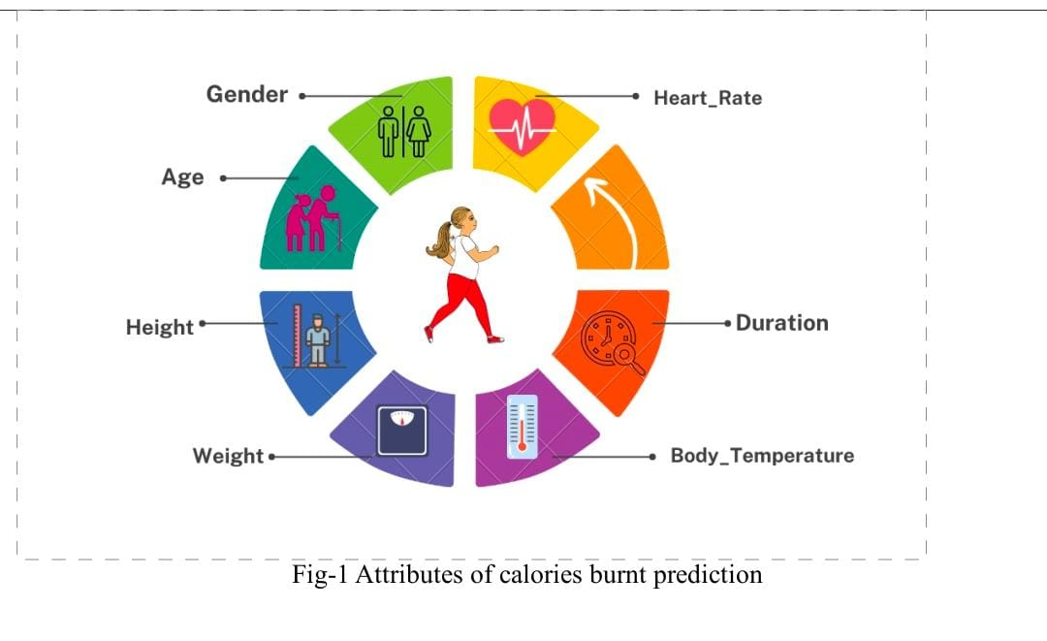
Attributes of Calorie Burnt Prediction

Slide 8


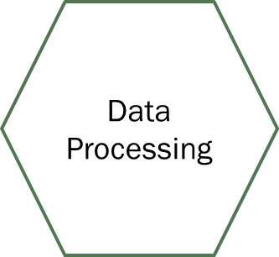



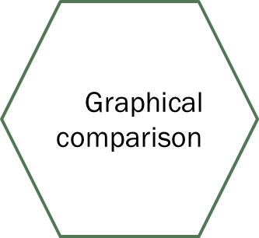
Work Flow

Slide 9

Graphical Representation
X-axis (Duration of Activity): This axis represents the independent variable, which is the duration of the activity (in minutes or hours).
Y-axis (Calories Burned): This axis represents the dependent variable ,which is the amount of calories burned during the activity session.

Slide 10
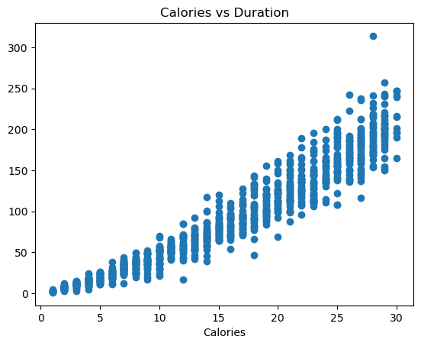
Scatter Plot
Interpretation :-
In this Plot we observed that points generally trend upwards from left to right, it suggests that as the duration of the activity increases, so does the number of calories burned. This indicates a positive correlation between duration and calories burned.

Slide 11
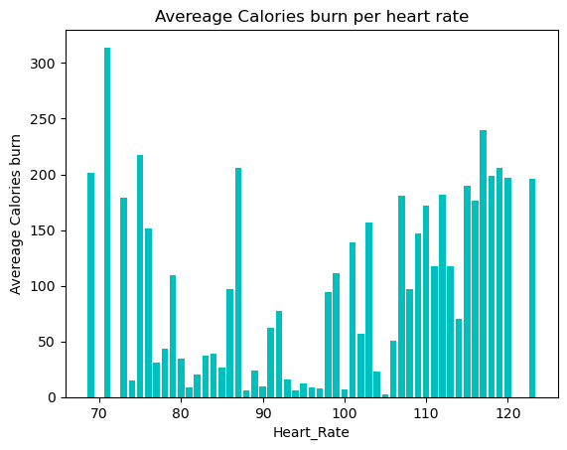
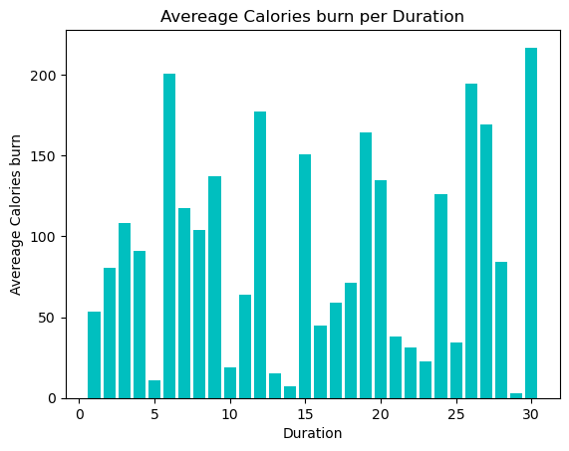
Bar Plot
Interpretation:
It indicates that there is higher average calorie burn rate for 70 Beats per minute heart rate zone. This suggests that activities within this zone tend to burn more calories per hour.
Interpretation:
This Shows that 30 min Duration of Exercise the most Calories burn on .

Slide 12
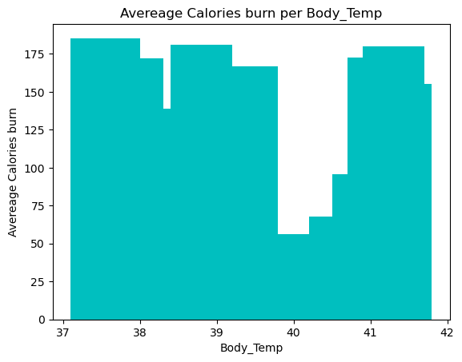
Interpretation :-
This bar plot helps in understanding the relationship between body temperature and calorie burn efficiency. A taller bar indicates a higher average calorie burn rate for that body temperature range.
This suggests that individuals tend to burn more calories per hour when their body temperature falls within 37.6°C - 38.5°C.

Slide 13
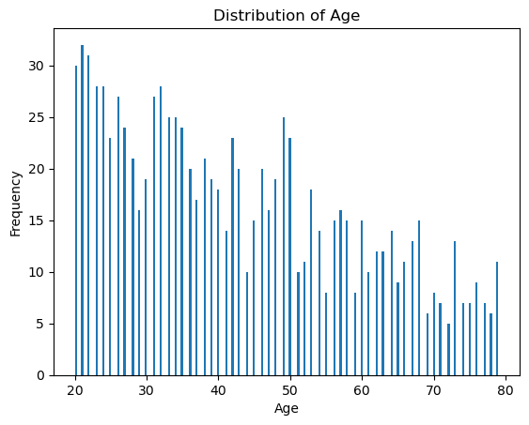
Interpretation :-
We can observe That how average calorie burn varies across different age groups. Younger individuals burn more calories due to higher activity levels or metabolism, whereas older individuals have different metabolic rates affecting their calorie burn.

Slide 14
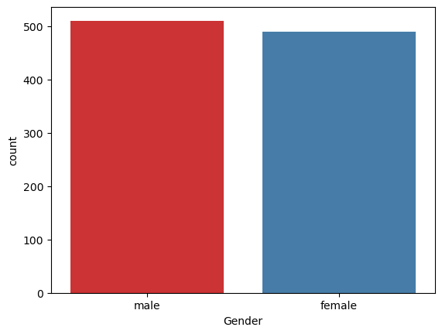
Count Chart
Interpretation :-
It provides the distribution of male is 51%and female 49% participants within the dataset.

Slide 15

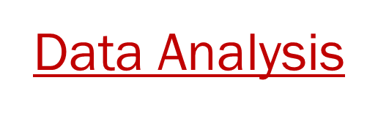
Algorithm used :-
1. Linear Regression 2. KNN 3. Decision Tree 4. Random Forest 5. Bagging 6. Boosting 7. Stacking 8. SVM 9. Voting 10. Neural network

Slide 16
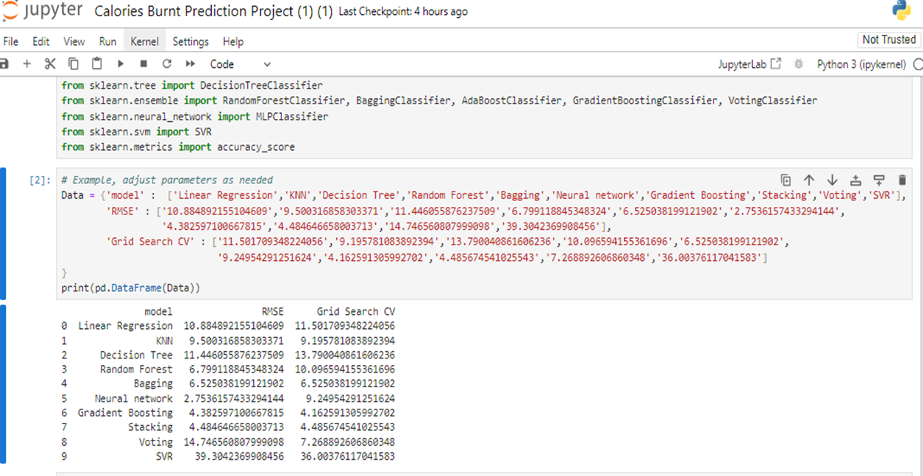
COMPARISION OF RMSE OF MODELS

Slide 17
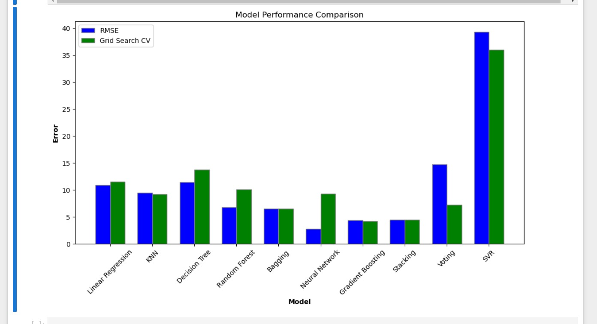

Slide 18
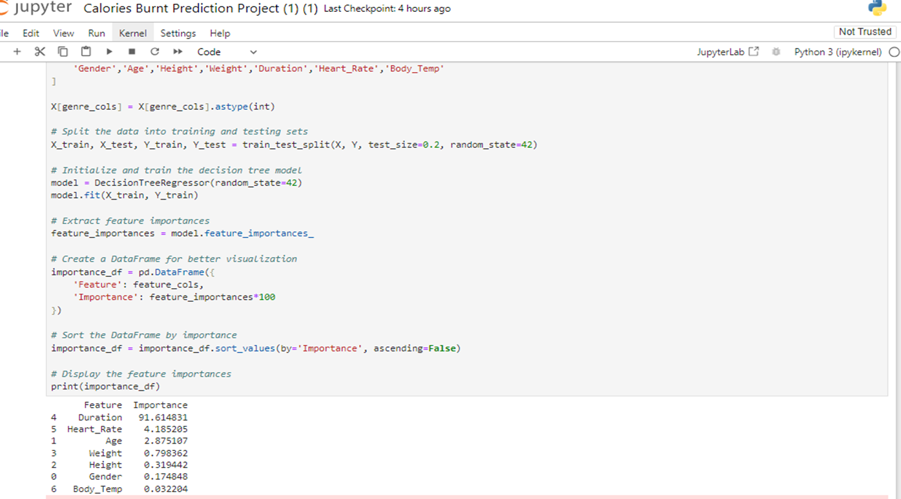
IMPORTANT FEATURES
Interpretation : The most important features Duration with importance 91.614831

Slide 19
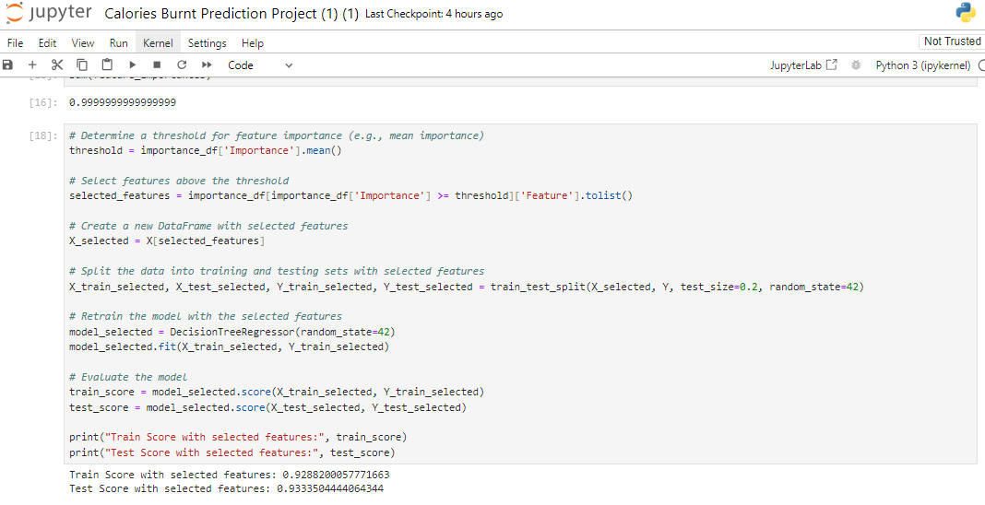
TRAIN AND TEST SCORE OF IMPORTANT FEATURE
Train Score : 0.9288
Test Score : 0.9335

Slide 20
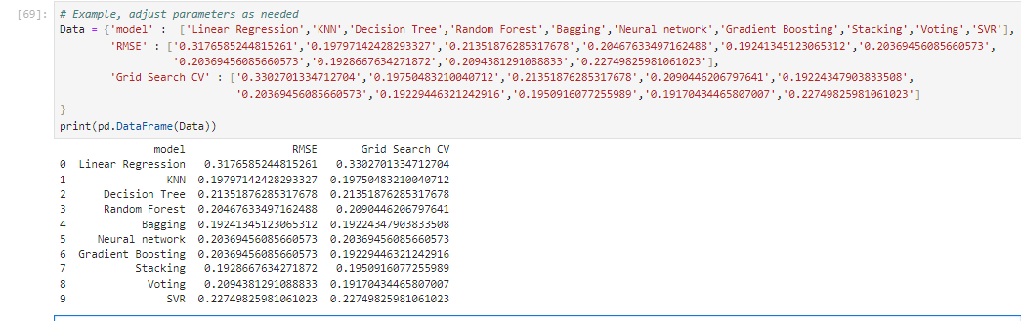
RMSE OF AFTER IMPORTANT FEATURE

Slide 21
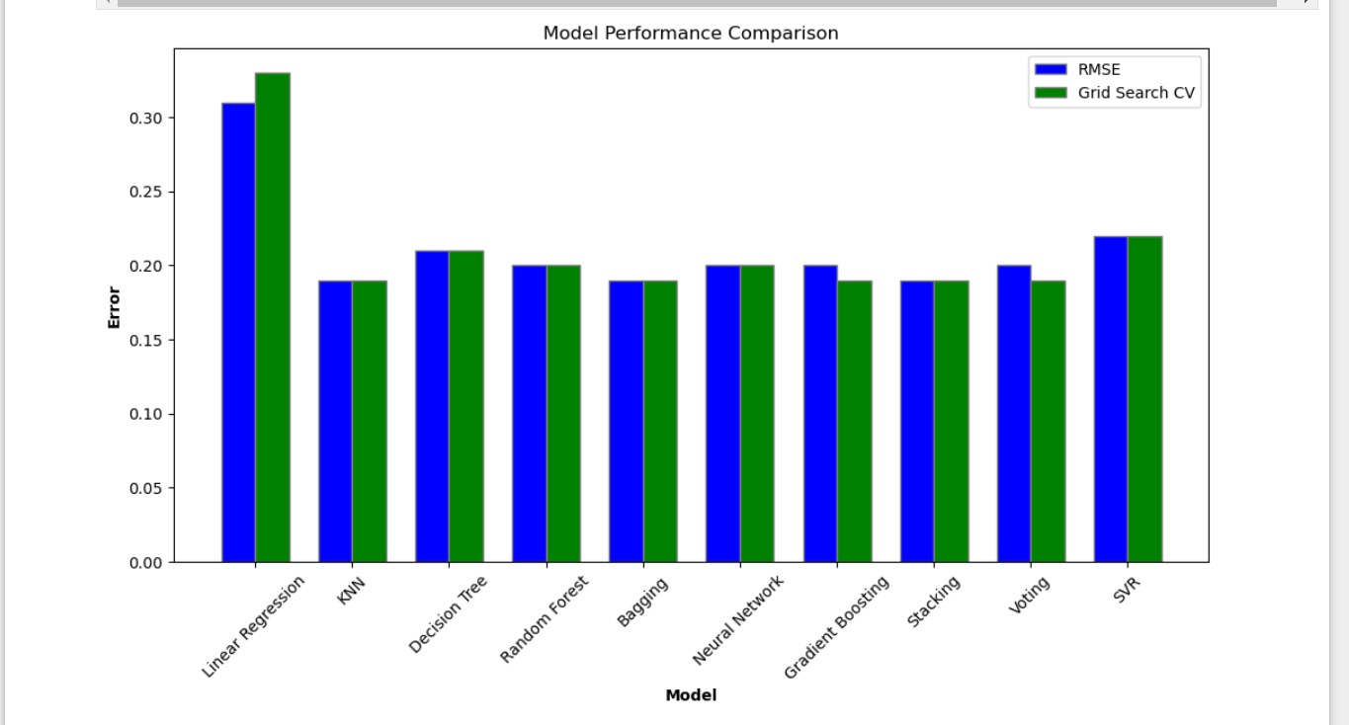

Slide 22
Best Performing Models (Lowest RMSE): Bagging: It has the lowest RMSE of 0.1924 and also performs consistently well according to Grid Search CV. KNN: It also shows a low RMSE of 0.1979 and a competitive Grid Search CV score.
Consistency in Performance:
Decision Tree, Random Forest, Neural Network, and Gradient Boosting all show a similar RMSE around 0.20, indicating good performance.
Stacking and Voting methods also perform well with an RMSE of around 0.1928 and 0.2094 respectively, though Voting has a notably good Grid Search CV score.

Slide 23

Conclusion
This research aimed to recognize the number of calories our body burns, which depends on several factors such as age, body temperature, duration, and heart rate. It is important to understand the number of calories we eat to stay fit and healthy. From this we conclude that the Duration of Exercise is most effecting factor to burned calories . Bagging: It consistently shows the lowest RMSE (0.1924) and a competitive Grid Search CV score (0.1922). This indicates it performs well both in terms of prediction accuracy and model stability. Stacking and Voting: Both show low RMSE values (0.1929 and 0.2094 respectively) and strong Grid Search CV scores. Stacking slightly edges out Voting in terms of RMSE.

Slide 24
REFERENCES
Kaggle – https://www.kaggle.com/
W3school – https://www.w3schools.com/
Github – https://github.com/
GeeksforGeeks – https://www.geeksforgeeks.org/
Youtube - https://www.youtube.com/

Slide 26


